Slide 1
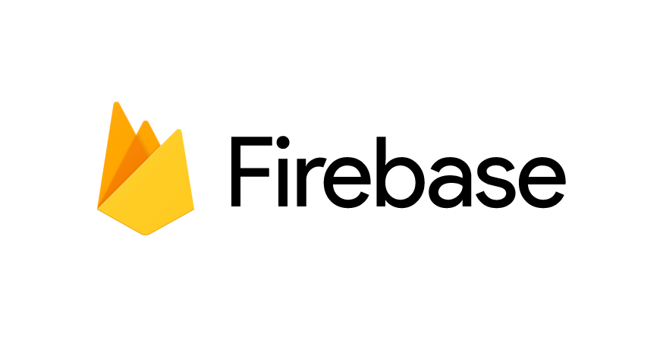
Introduction to

Slide 2
#GeekAlert

Slide 3
#teamFirebase

Slide 4
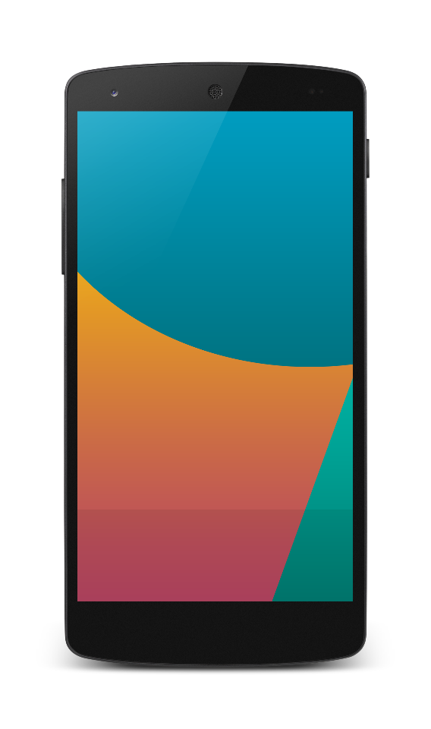
To develop a mobile application
What people think

Slide 5
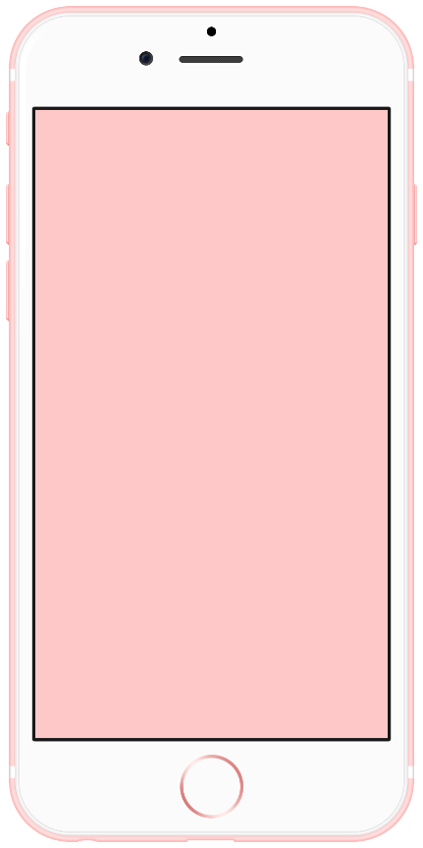
To develop a mobile application
Reality

Slide 6
To develop a mobile application
Reality
Authentication
Database
Storage
Analytics
Crash Reporting
Push Notifications
Web Hosting
etc.

Slide 7



To develop a mobile application
Reality
Authentication
Database
Storage
Analytics
Crash Reporting
Push Notifications
Web Hosting
etc.

Slide 8


To develop a mobile application
System Admin
Authentication
Database
Storage
Analytics
Crash Reporting
Push Notifications
Web Hosting
etc.
@()$*!)@JHO(@)$#(!I_)@
Backend Developer 1
Backend Developer 2

Slide 9
@()$*!)@JHO(@)$#(!I_)@
…

Slide 10


Slide 11
To develop a mobile application
Reality
Authentication
Database
Storage
Analytics
Crash Reporting
Push Notifications
Web Hosting
etc.

Slide 12
To develop a mobile application
Authentication
Database
Storage
Analytics
Crash Reporting
Push Notifications
Web Hosting
etc.

Slide 13

To develop a mobile application

Slide 14
To develop a mobile application
REST?
REST?

Slide 15
To develop a mobile application
Android SDK
iOS SDK

Slide 16
With Firebase
Compact team: You don’t need to hire Backend engineers
Fast iteration
Scalable
Your team can sleep at night !

Slide 17

Realtime Database
Authentication
Hosting

Slide 18
Here comes the new

Slide 19

DEVELOP
GROW
Backend Services
Realtime Database
Authentication
Hosting
Storage
Cloud Messaging
Remote Config
App Quality Services
Test Lab for Android
Crash Reporting
Acquisition
Dynamic Links
Invites
AdWords
Re-Engagement
Notifications
App Indexing
Analytics
EARN
In-app Ads
AdMob

Slide 20
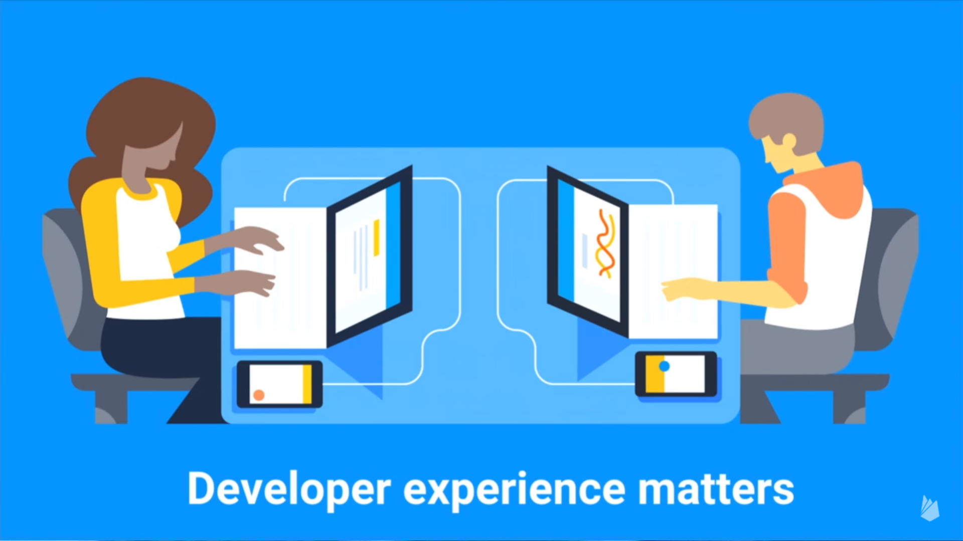

Slide 21
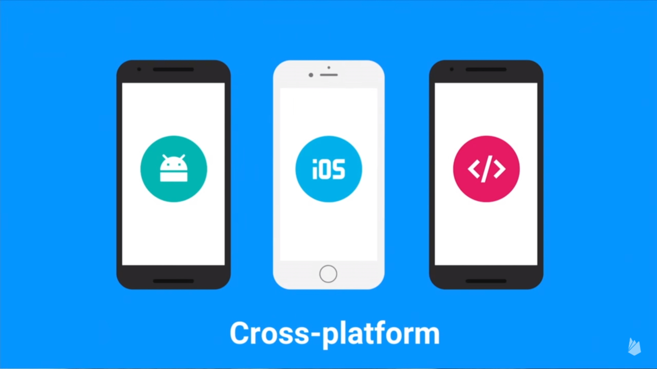

Slide 22
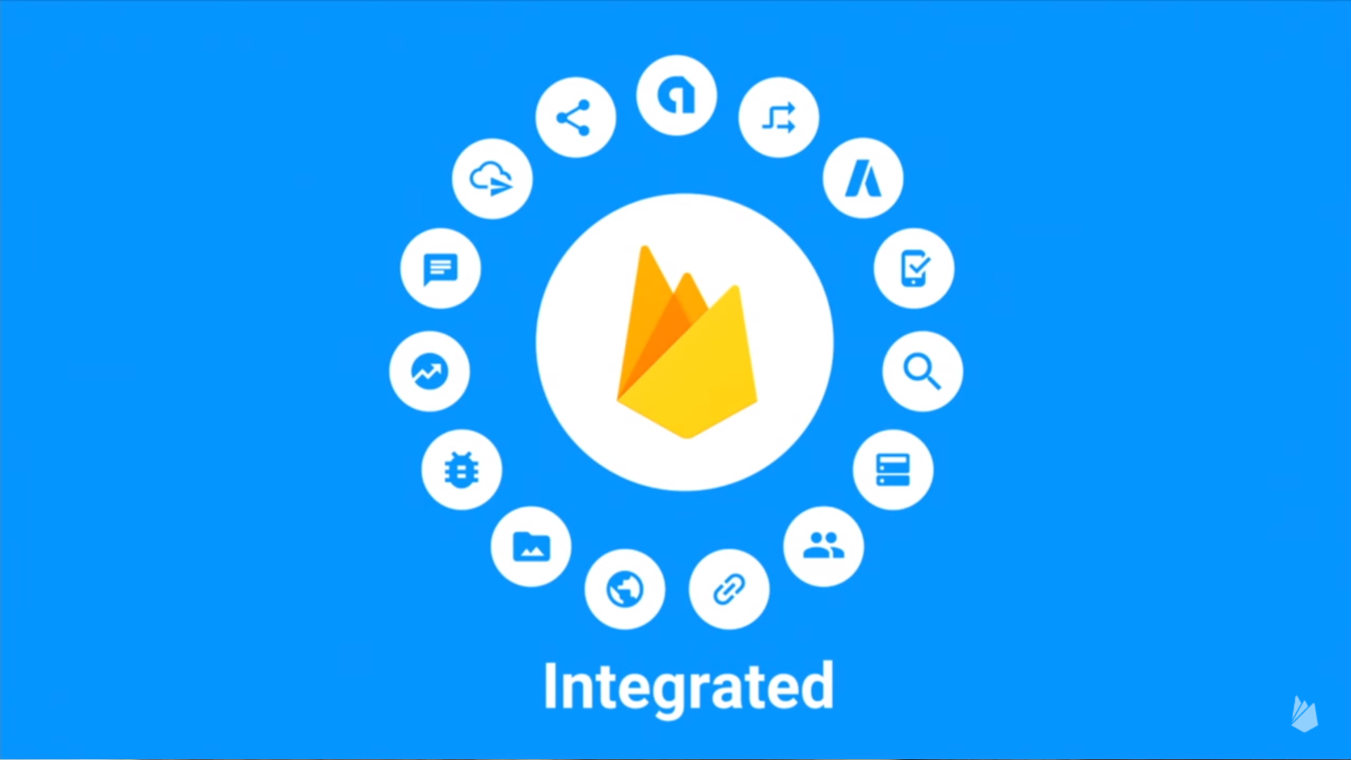

Slide 23
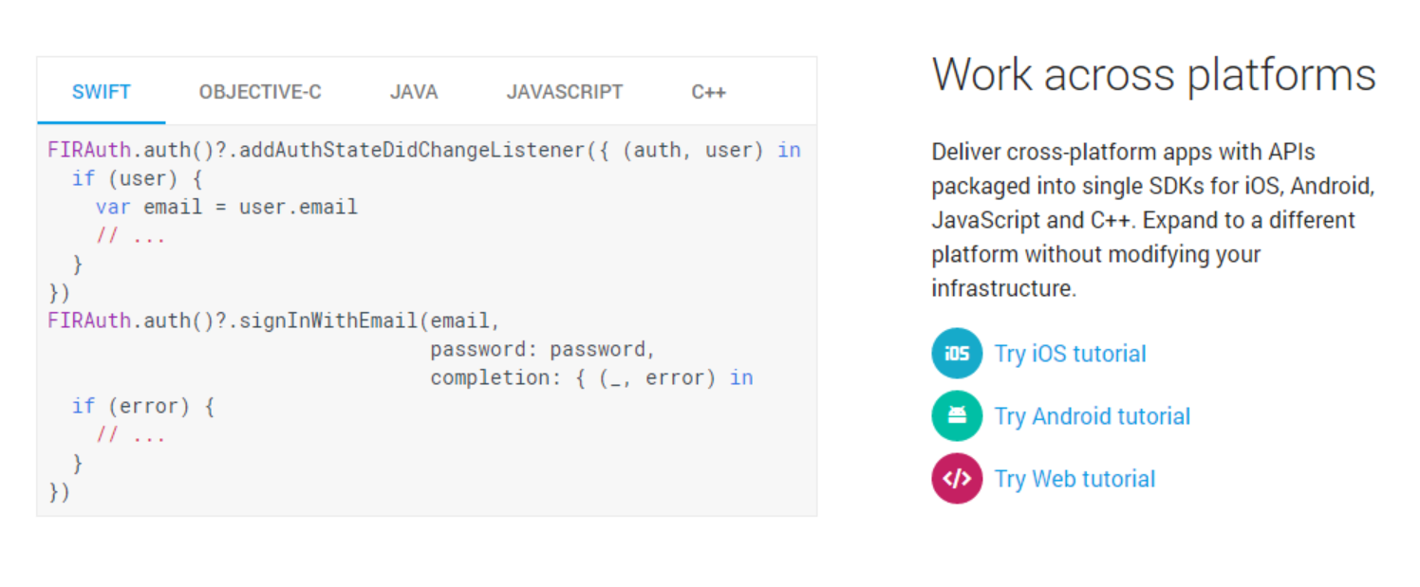
Easy to read documentation

Slide 24
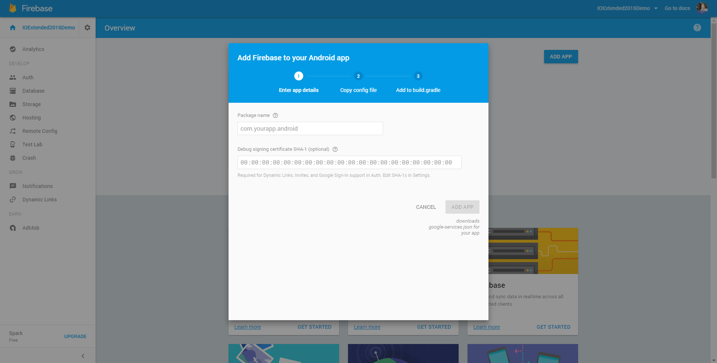
Firebase: Get Started

Slide 25
Firebase
Strongly Integrated with Android Studio 2.2
You can integrate Firebase with your app with just few clicks !
[Live Demo]

Slide 26
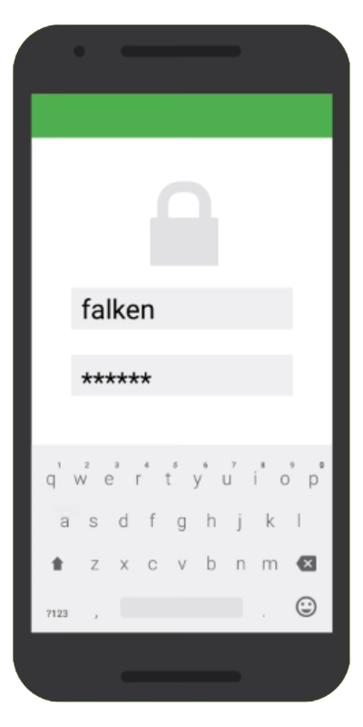

Authentication
Register / Login with
Email + Password
Google
Facebook
Twitter
GitHub
Email address verification
Password reset

Slide 27
Authentication
private FirebaseAuth mAuth;
// ...
mAuth = FirebaseAuth.getInstance();

Slide 28
Creating User
mAuth.createUserWithEmailAndPassword(email, password)
.addOnCompleteListener(this, new OnCompleteListener<AuthResult>() {
@Override
public void onComplete(@NonNull Task<AuthResult> task) {
Log.d(TAG, "createUserWithEmail:onComplete:" + task.isSuccessful());
if (!task.isSuccessful()) {
Toast.makeText(EmailPasswordActivity.this,
"Authentication failed.",
Toast.LENGTH_SHORT).show();
}
// ...
}
});

Slide 29
Logging In
mAuth.signInWithEmailAndPassword(email, password)
.addOnCompleteListener(this, new OnCompleteListener<AuthResult>() {
@Override
public void onComplete(@NonNull Task<AuthResult> task) {
Log.d(TAG, “signInWithEmail:onComplete:" + task.isSuccessful());
if (!task.isSuccessful()) {
Toast.makeText(EmailPasswordActivity.this,
"Authentication failed.",
Toast.LENGTH_SHORT).show();
}
// ...
}
});

Slide 30
Sign Out
FirebaseAuth.getInstance().signOut();

Slide 31
Facebook Login
mCallbackManager = CallbackManager.Factory.create();
LoginButton loginButton = (LoginButton) findViewById(R.id.button_facebook_login);
loginButton.setReadPermissions("email", "public_profile");
loginButton.registerCallback(mCallbackManager, new FacebookCallback<LoginResult>() {
@Override
public void onSuccess(LoginResult loginResult) {
Log.d(TAG, "facebook:onSuccess:" + loginResult);
handleFacebookAccessToken(loginResult.getAccessToken());
}
@Override
public void onCancel() { }
@Override
public void onError(FacebookException error) { }
});

Slide 32
Facebook Login
private void handleFacebookAccessToken(AccessToken token) { Log.d(TAG, "handleFacebookAccessToken:" + token); AuthCredential credential = FacebookAuthProvider.getCredential(token.getToken()); mAuth.signInWithCredential(credential) .addOnCompleteListener(this, new OnCompleteListener<AuthResult>() { @Override public void onComplete(@NonNull Task<AuthResult> task) { Log.d(TAG, "signInWithCredential:onComplete:" + task.isSuccessful()); // If sign in fails, display a message to the user. If sign in succeeds // the auth state listener will be notified and logic to handle the // signed in user can be handled in the listener. if (!task.isSuccessful()) { Log.w(TAG, "signInWithCredential", task.getException()); Toast.makeText(FacebookLoginActivity.this, "Authentication failed.", Toast.LENGTH_SHORT).show(); } // ... } }); }

Slide 33

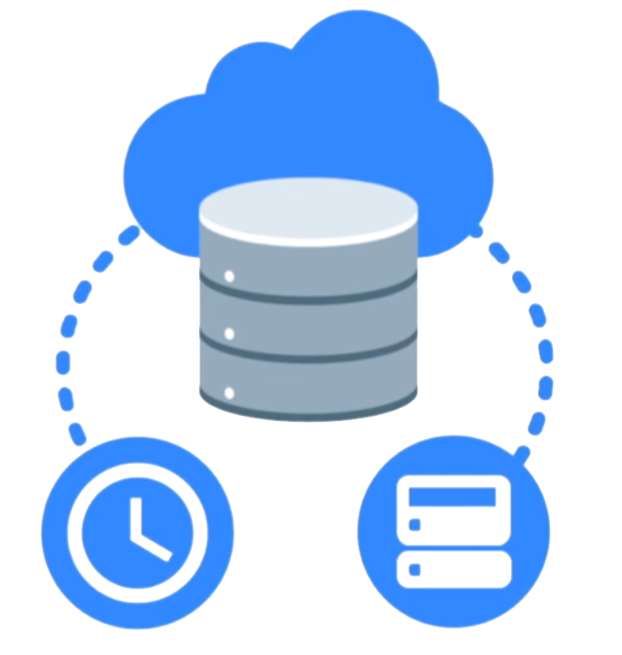
Realtime Database
Cloud-hosted NoSQL database
Synchronization & conflict resolution
Access directly from your app

Slide 34
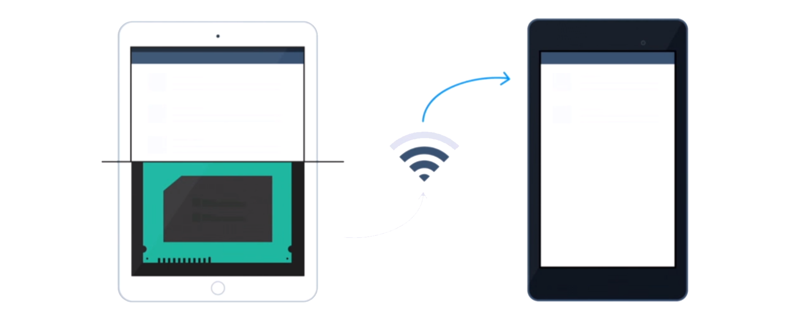
Realtime Database

Slide 35
Realtime Database
// Write a message to the database FirebaseDatabase database = FirebaseDatabase.getInstance(); DatabaseReference myRef = database.getReference("message"); myRef.setValue("Hello, World!");

Slide 36
Realtime Database
// Read from the database myRef.addValueEventListener(new ValueEventListener() { @Override public void onDataChange(DataSnapshot dataSnapshot) { // This method is called once with the initial value and again // whenever data at this location is updated. String value = dataSnapshot.getValue(String.class); Log.d(TAG, "Value is: " + value); } @Override public void onCancelled(DatabaseError error) { // Failed to read value Log.w(TAG, "Failed to read value.", error.toException()); } });

Slide 37

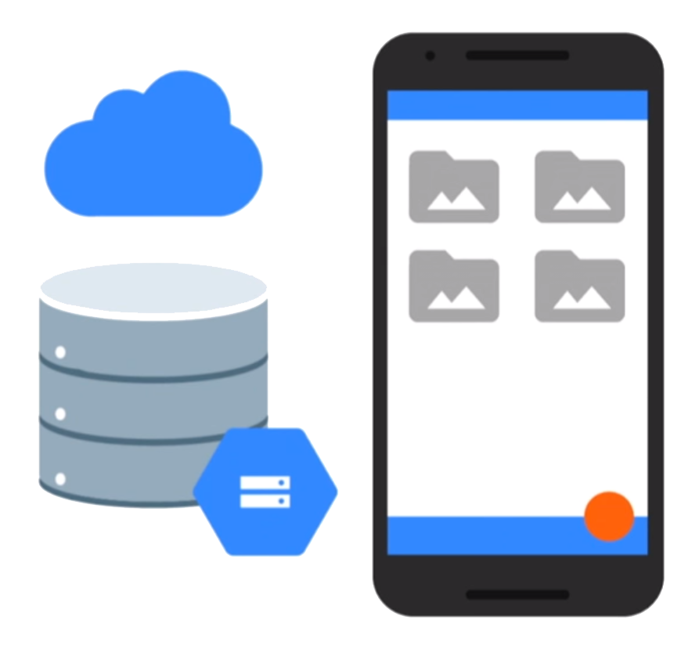
Storage
Easy file storage
Handles poor connectivity
Backed by & accessible from Google Cloud Storage

Slide 38
Storage
FirebaseStorage storage = FirebaseStorage.getInstance();

Slide 39
Uploading a file
Uri file = Uri.fromFile(new File("path/to/images/rivers.jpg"));
StorageReference riversRef = storageRef.child("images/"+file.getLastPathSegment()); uploadTask = riversRef.putFile(file);
// Register observers to listen for when the download is done or if it fails uploadTask.addOnFailureListener(new OnFailureListener() { @Override public void onFailure(@NonNull Exception exception) { // Handle unsuccessful uploads } }).addOnSuccessListener(new OnSuccessListener<UploadTask.TaskSnapshot>() { @Override public void onSuccess(UploadTask.TaskSnapshot taskSnapshot) { // taskSnapshot.getMetadata() contains file metadata such as size,
// content-type, and download URL. Uri downloadUrl = taskSnapshot.getDownloadUrl(); } });

Slide 40
Downloading a file
islandRef = storageRef.child("images/island.jpg"); File localFile = File.createTempFile("images", "jpg"); islandRef.getFile(localFile)
.addOnSuccessListener(new OnSuccessListener<FileDownloadTask.TaskSnapshot>() { @Override public void onSuccess(FileDownloadTask.TaskSnapshot taskSnapshot) { // Local temp file has been created } }).addOnFailureListener(new OnFailureListener() { @Override public void onFailure(@NonNull Exception exception) { // Handle any errors } });

Slide 41

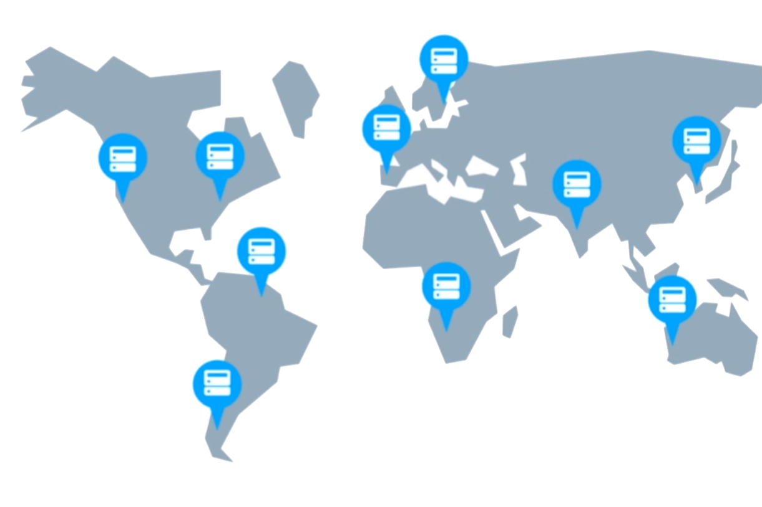
Hosting
Serve static assets
SSL by default

Slide 42
Hosting
Install the Firebase CLI
npm install –g firebase-tools
Initialize your app
$ firebase init
Add a file
Deploy your website
$ firebase deploy

Slide 43
Hosting
Install the Firebase CLI
npm install –g firebase-tools
Initialize your app
$ firebase init
Add a file
Deploy your website
$ firebase deploy

Slide 44

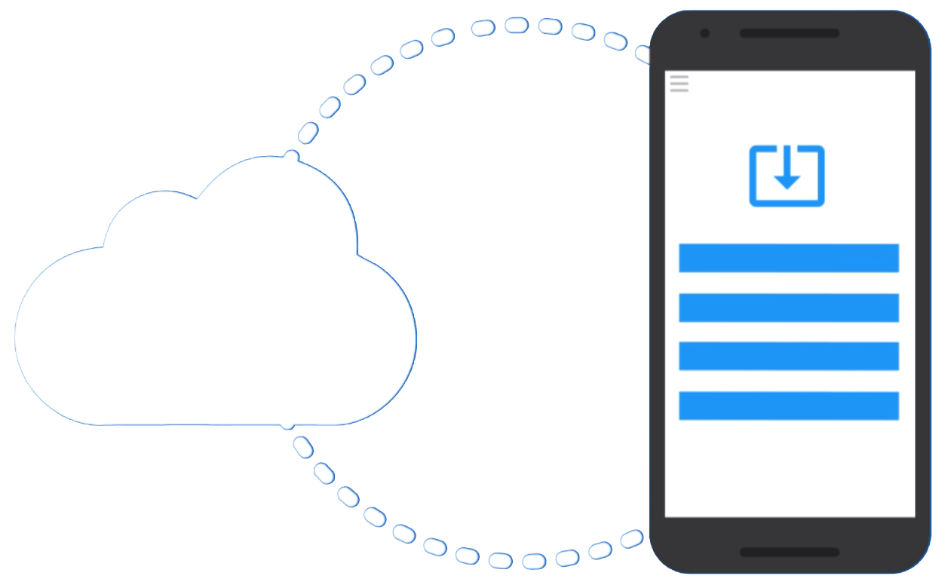
Remote Config
Dynamically configures your app on-the-fly
[Live Demo]

Slide 45
Remote Config
mFirebaseRemoteConfig = FirebaseRemoteConfig.getInstance();
Set default parameter value as a XML file in res/xml
Fetch new configurations with fetch() and replace the current one

Slide 46
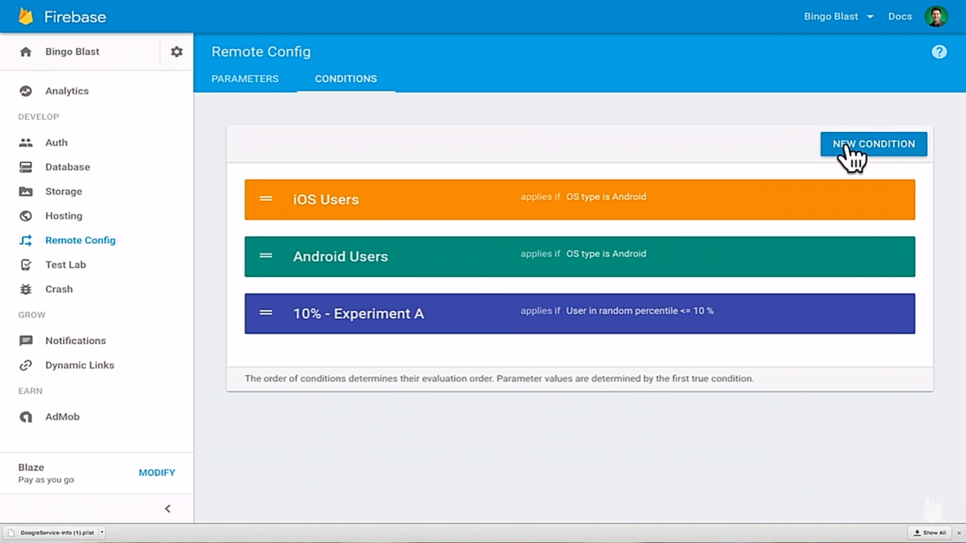

Slide 47

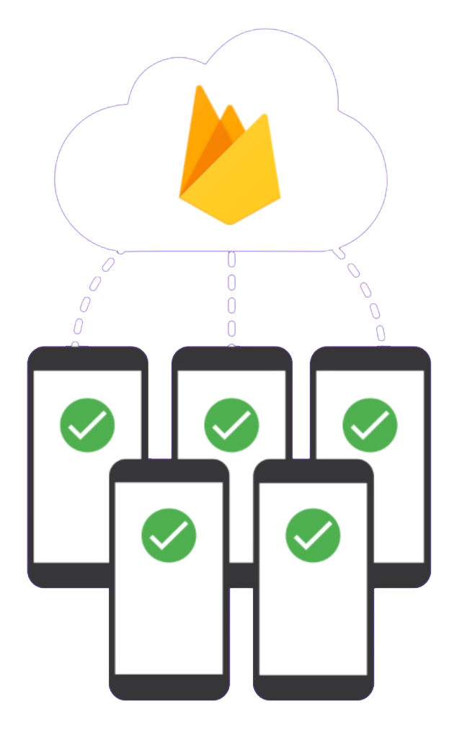
Cloud Messaging
Firebase Cloud Messaging (FCM)
Enable Push Notifications in just few LoCs
Build on top of GCM, switch to FCM !
See in details in the next session

Slide 48
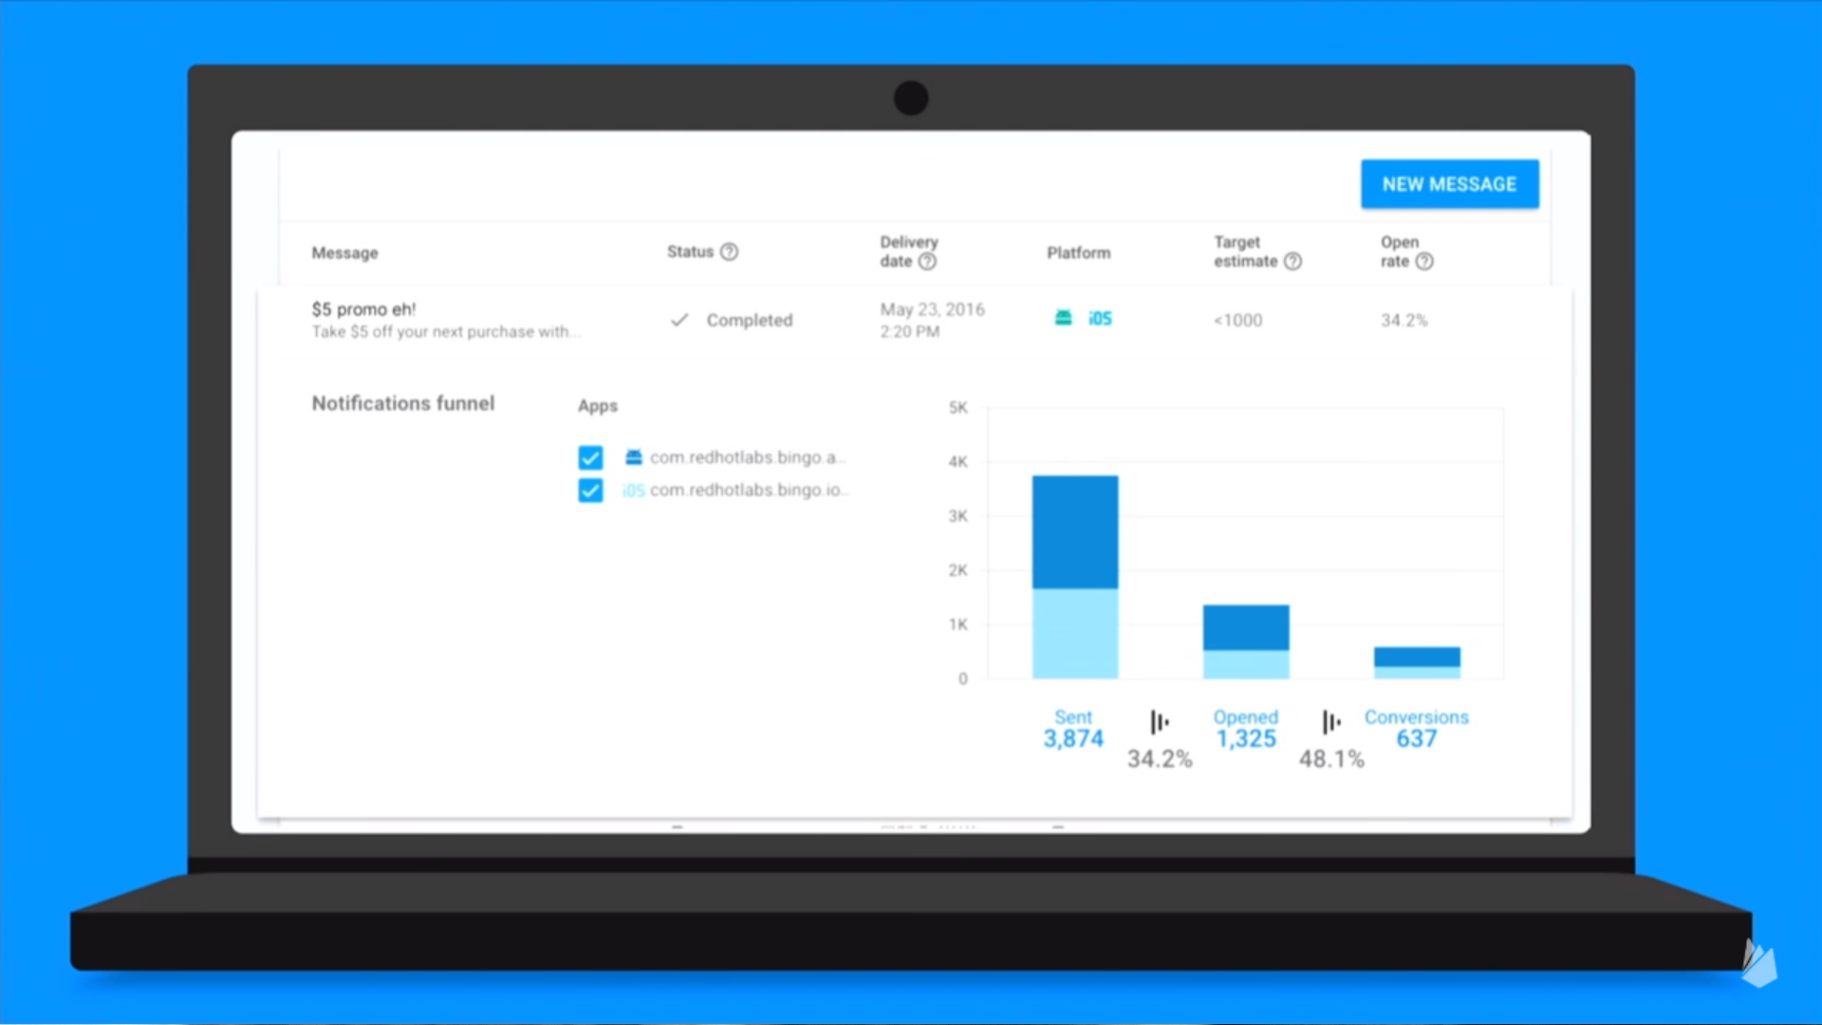

Slide 49
DEVELOP
GROW
Backend Services
Realtime Database
Authentication
Hosting
Storage
Cloud Messaging
Remote Config
App Quality Services
Test Lab for Android
Crash Reporting
Acquisition
Dynamic Links
Invites
AdWords
Re-Engagement
Notifications
App Indexing
Analytics
EARN
In-app Ads
AdMob

Slide 50
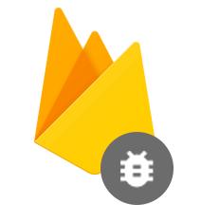
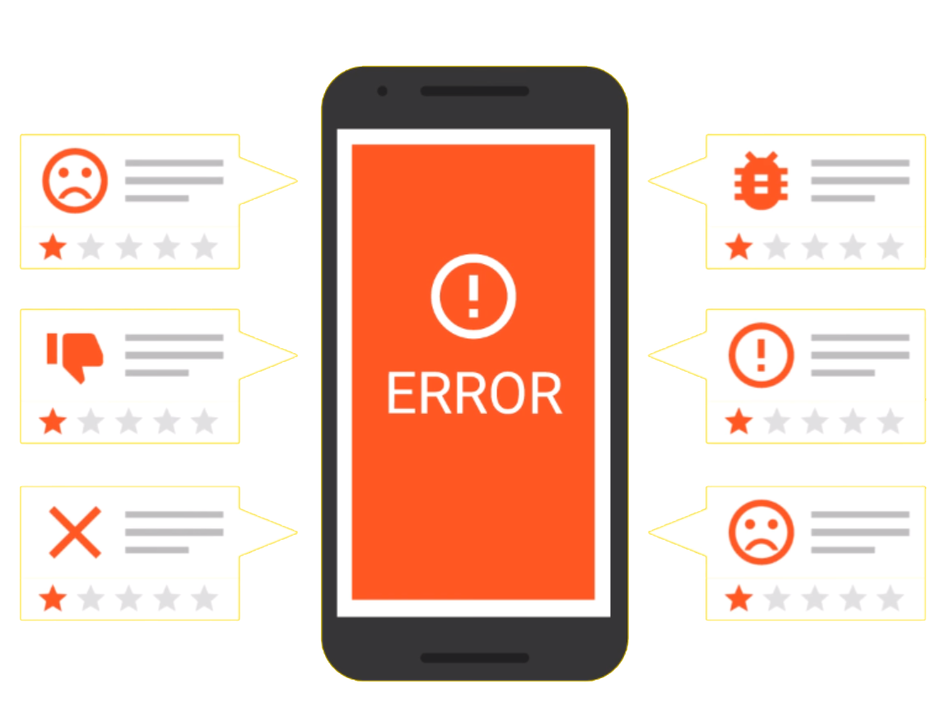
Crash Reporting
See crashes & impact
Version & OS drill-down
Integrated with Analytics

Slide 51
Crash Reporting
Basically just add dependency
compile 'com.google.firebase:firebase-crash:9.0.2'
FirebaseCrash.report(new Exception("My first Android non-fatal error"));
FirebaseCrash.log("Activity created");

Slide 52
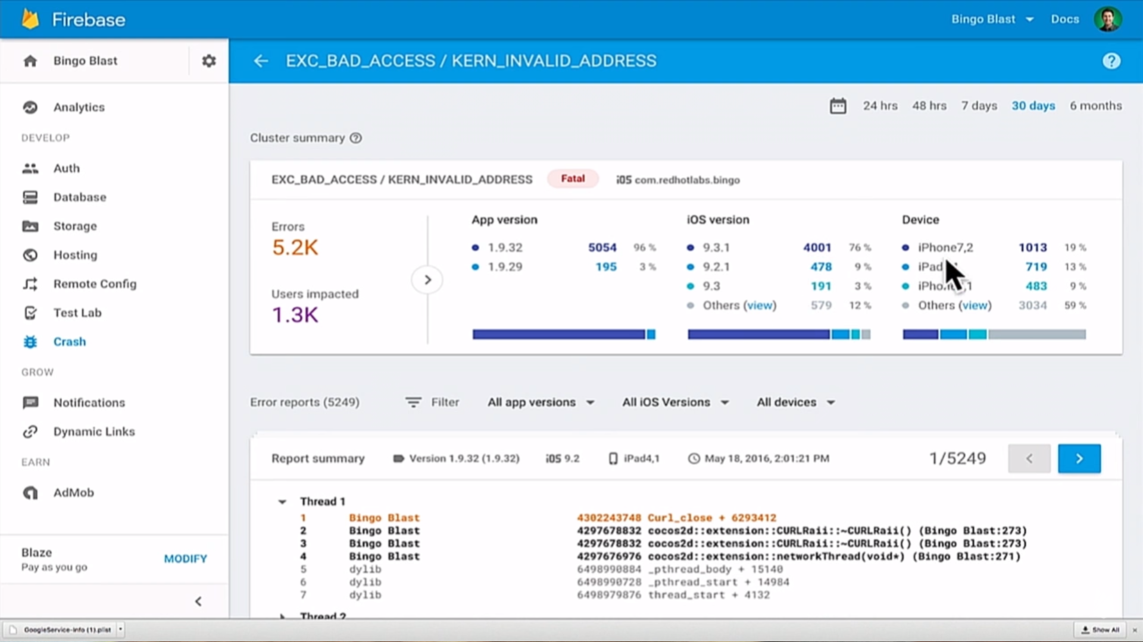

Slide 53

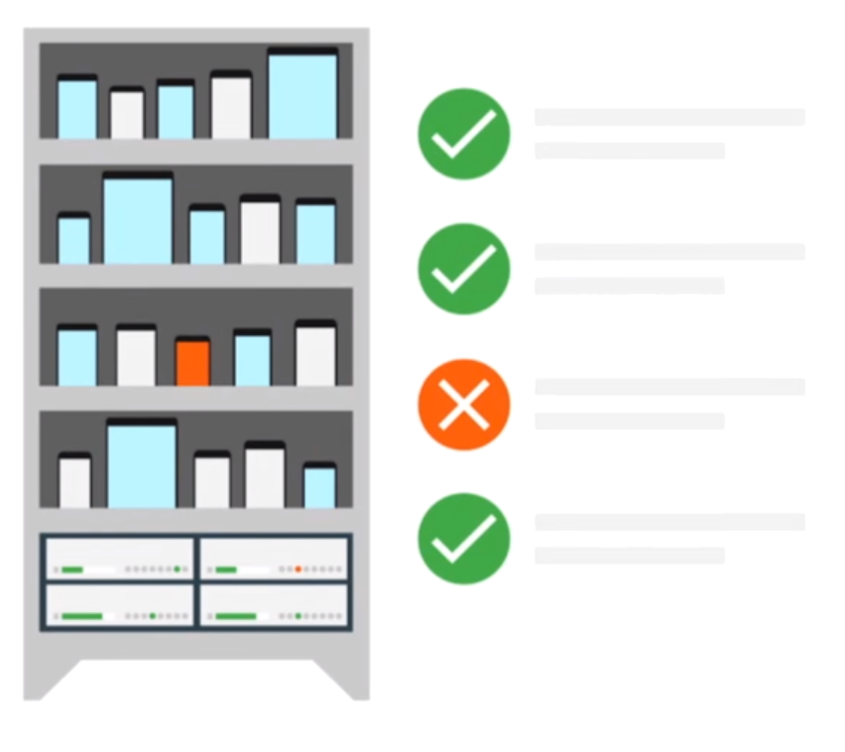
Test Lab
Test on the most popular devices before you ship
Reports & screenshots
Robo & custom tests

Slide 54
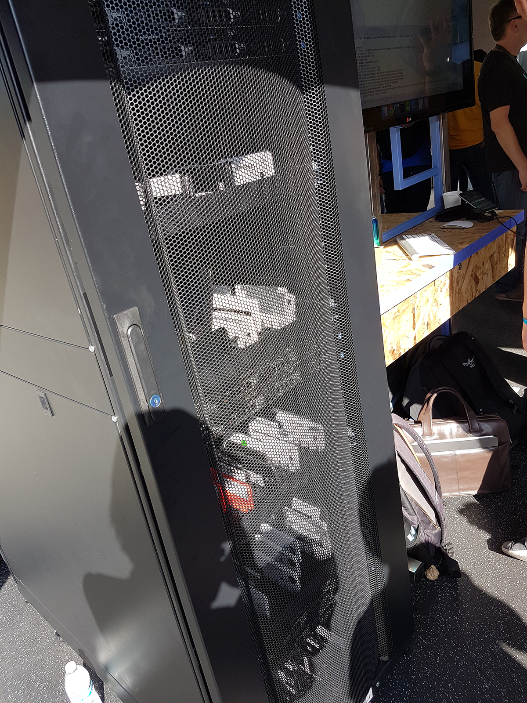
Test Lab
In Action

Slide 55
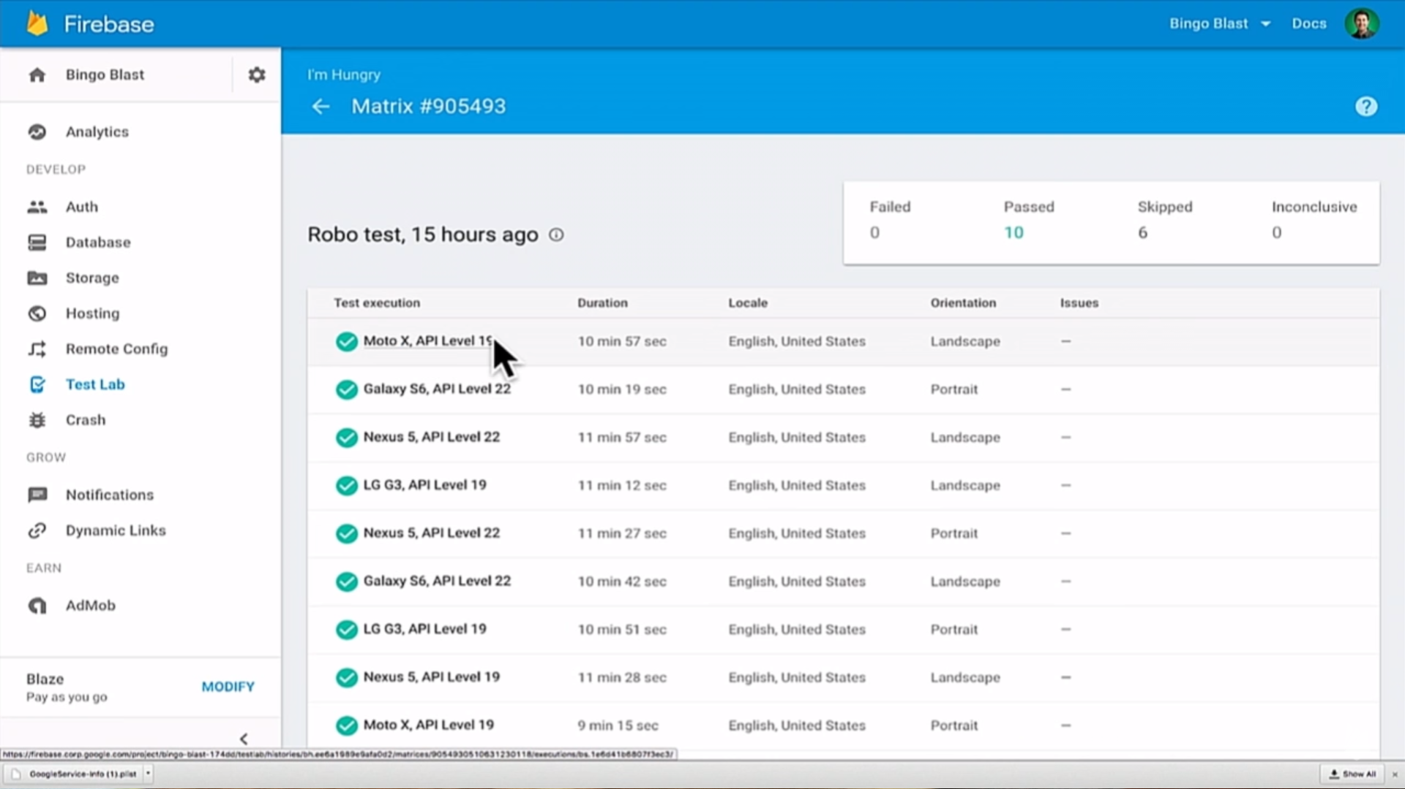

Slide 56
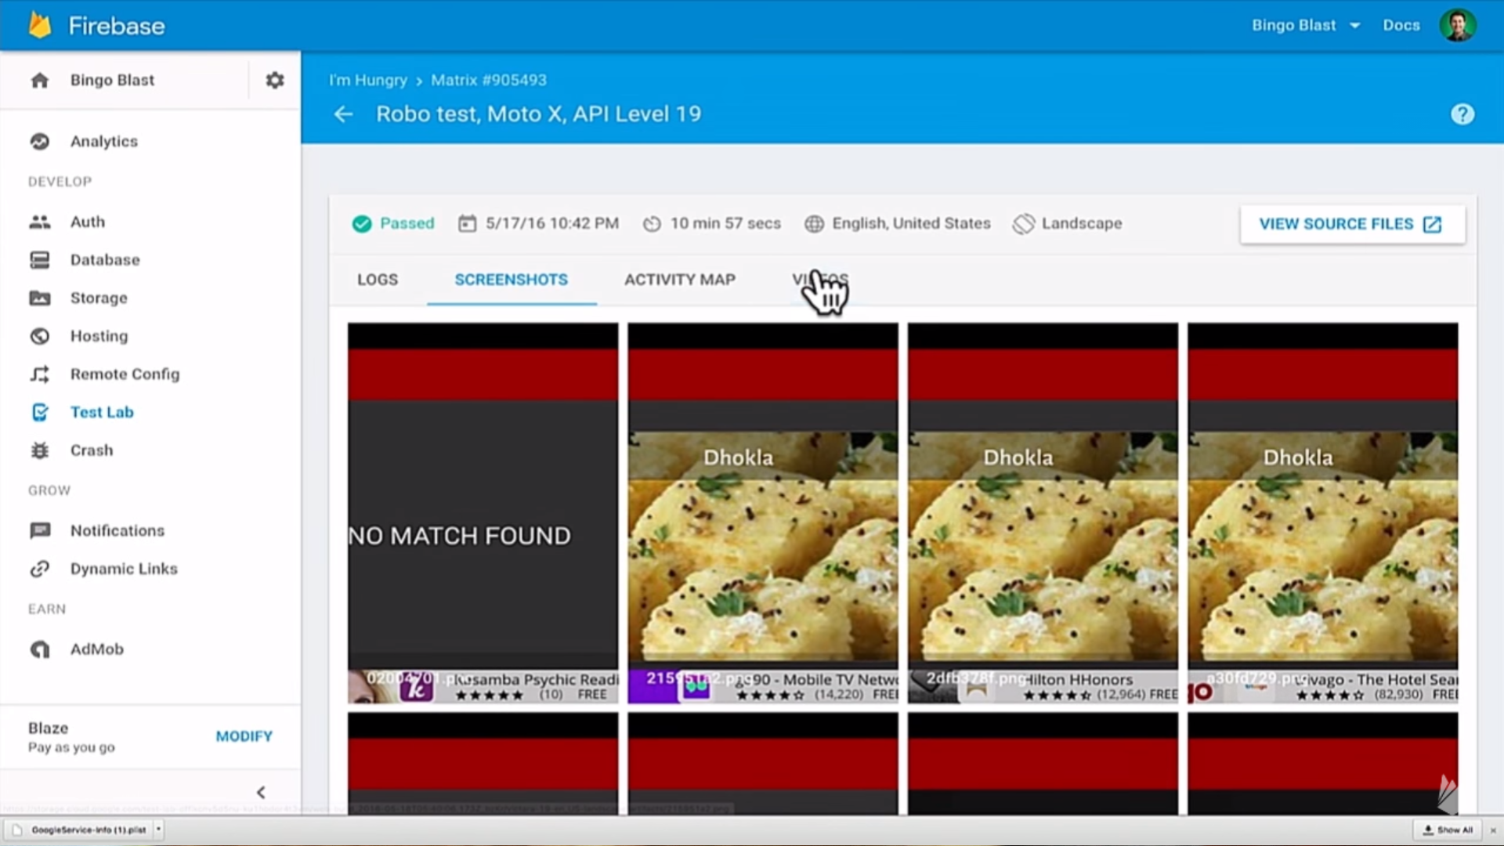

Slide 57
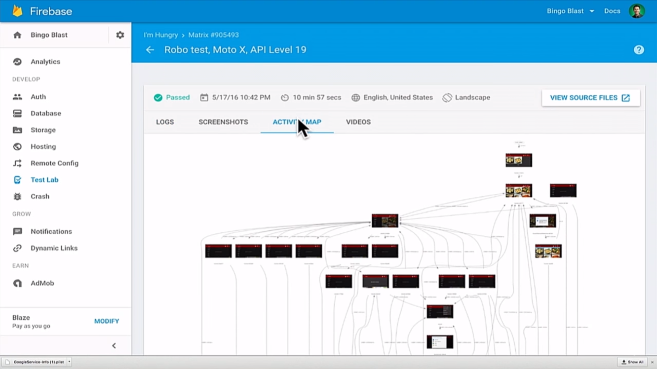

Slide 58
DEVELOP
GROW
Backend Services
Realtime Database
Authentication
Hosting
Storage
Cloud Messaging
Remote Config
App Quality Services
Test Lab for Android
Crash Reporting
Acquisition
Dynamic Links
Invites
AdWords
Re-Engagement
Notifications
App Indexing
Analytics
EARN
In-app Ads
AdMob

Slide 59

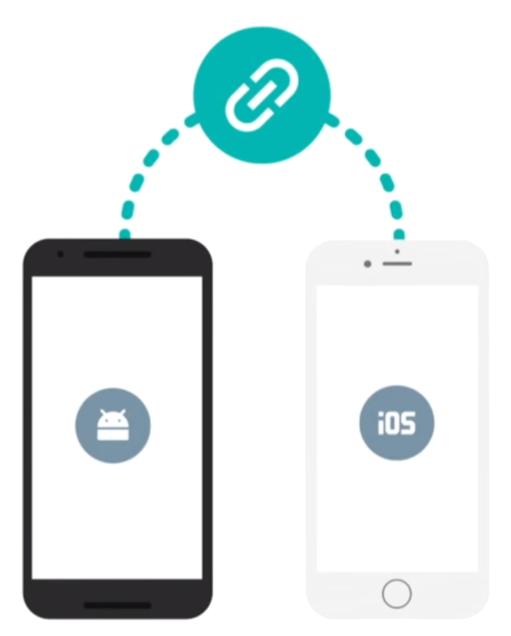
Dynamic Links
Customize different user experiences via a single URL
Works across platforms
Preserves URL state, even through app install flow
Analytics insights

Slide 60
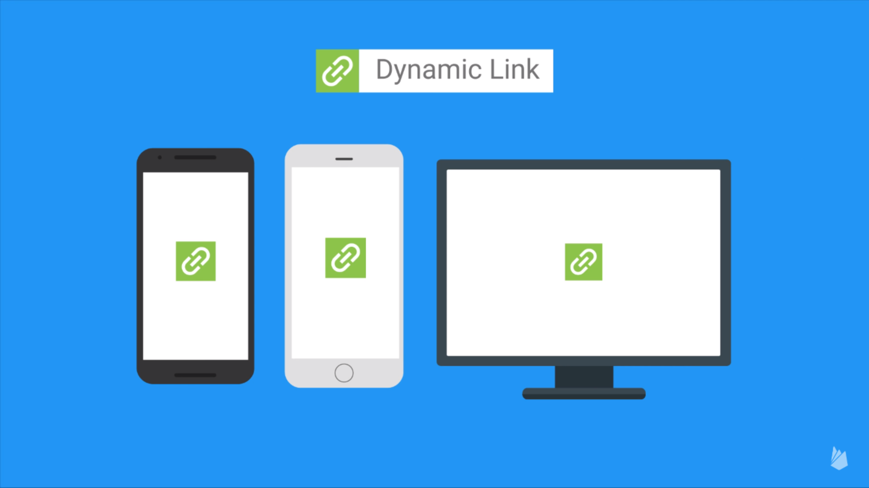

Slide 61
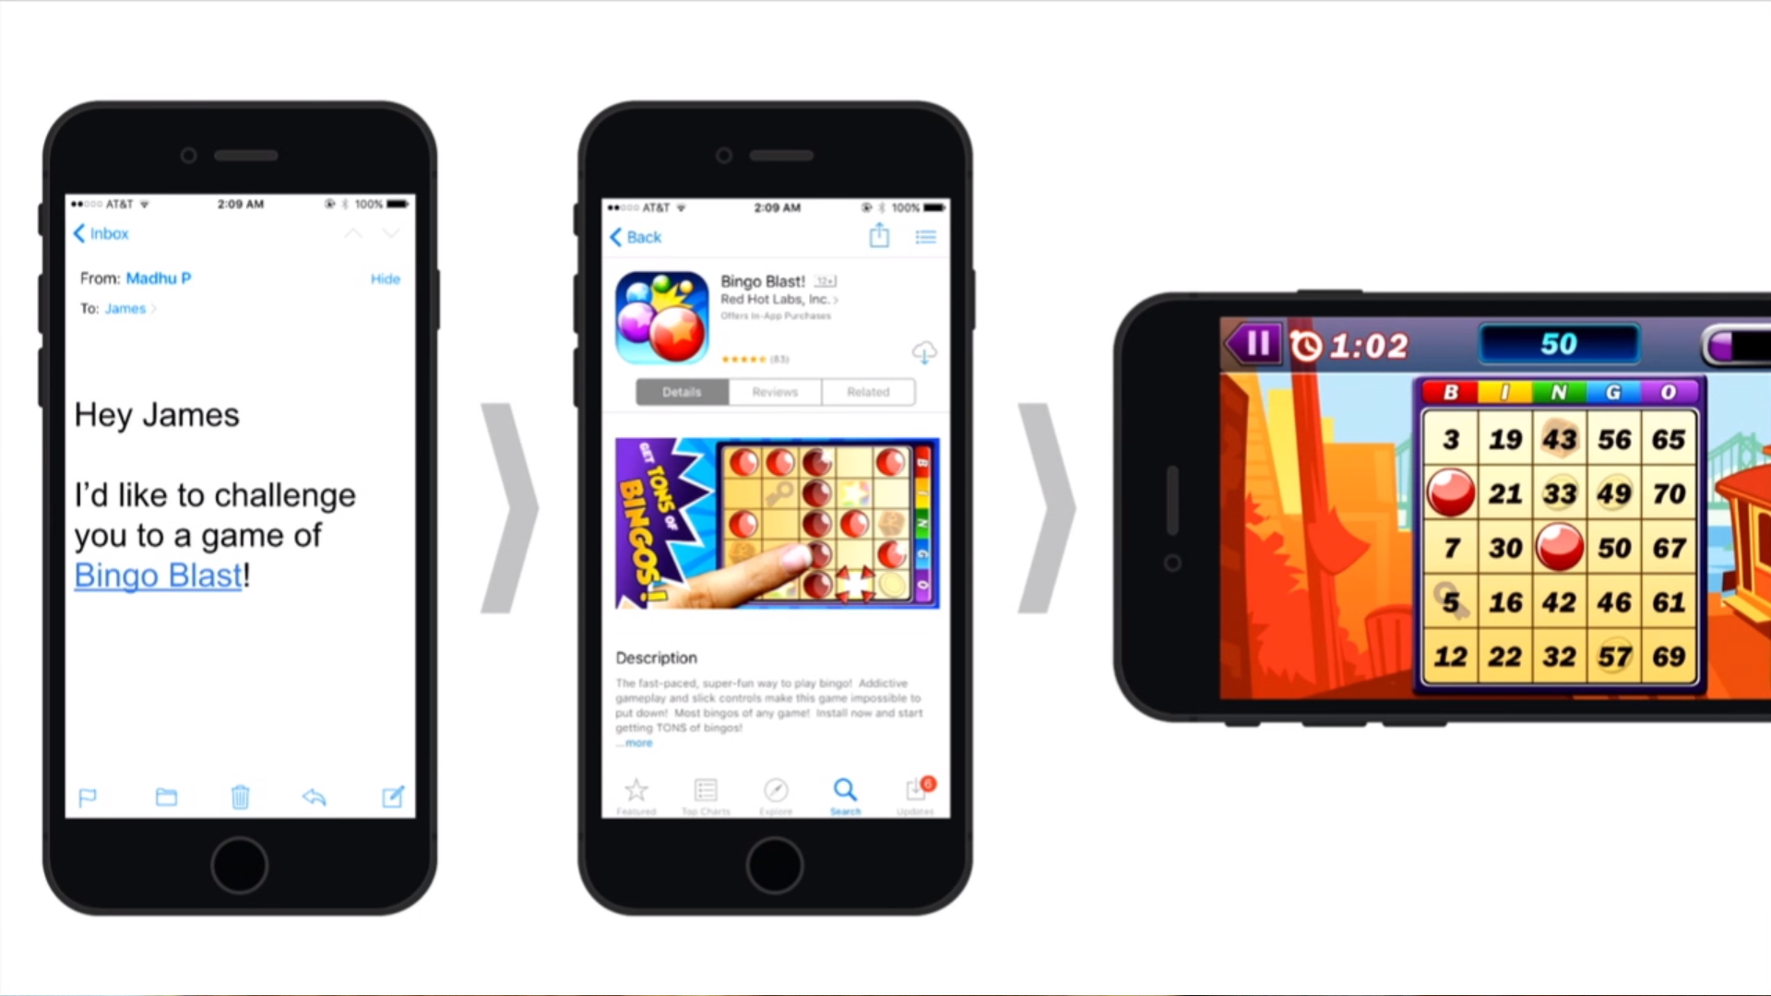

Slide 62

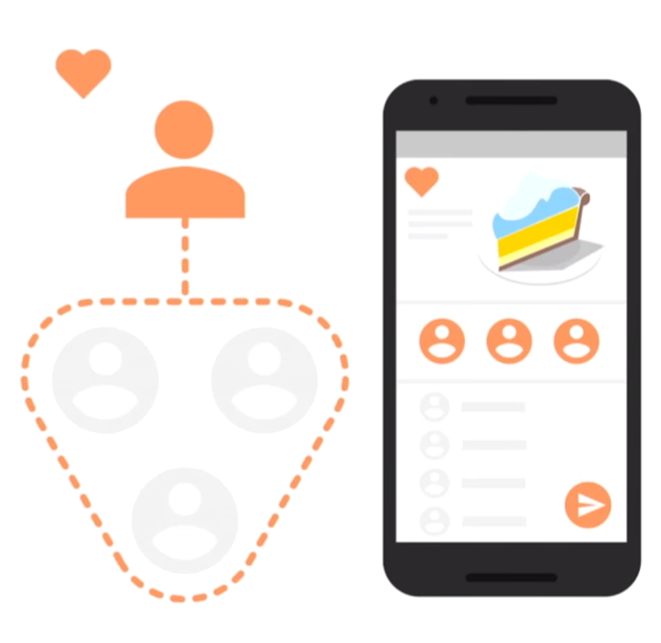
Invites
Drop-in widget for app sharing
Supports SMS and Email
Recipient suggestions from Google
Built on Dynamic Links

Slide 63
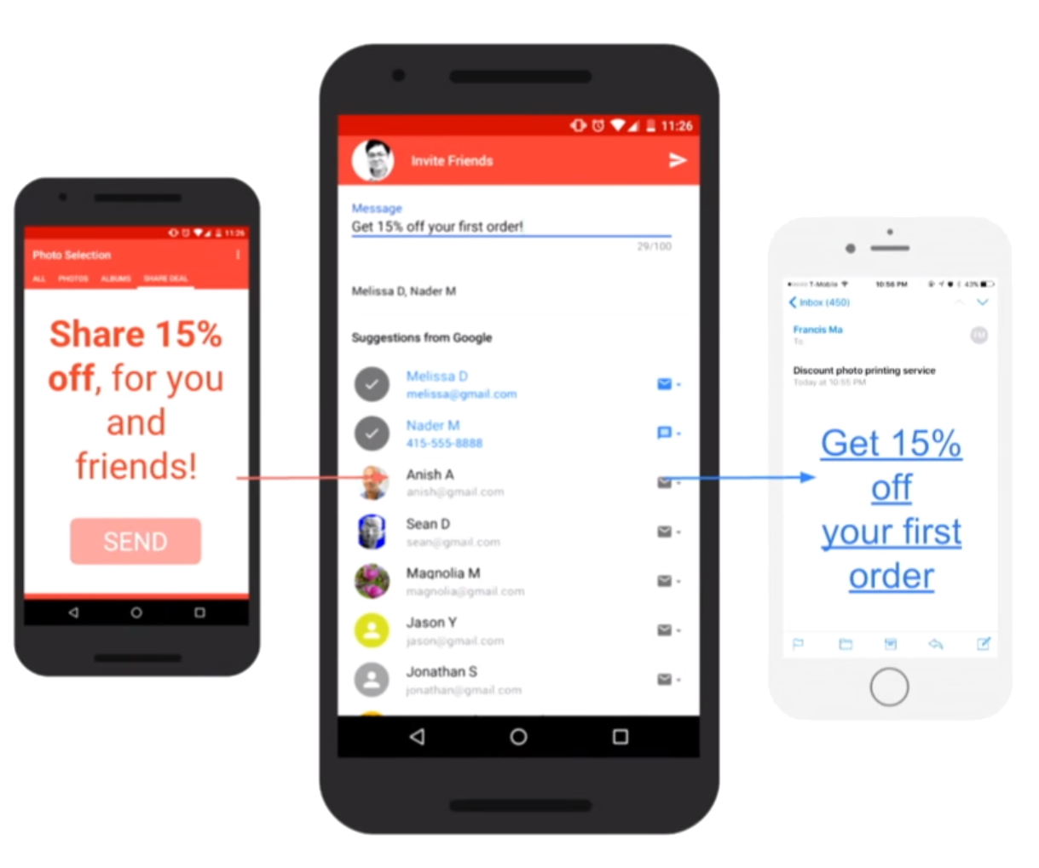
Invites

Slide 64
Invites
private void onInviteClicked() { Intent intent = new AppInviteInvitation
.IntentBuilder(getString(R.string.invitation_title)) .setMessage(getString(R.string.invitation_message)) .setDeepLink(Uri.parse(getString(R.string.invitation_deep_link))) .setCustomImage(Uri.parse(getString(R.string.invitation_custom_image))) .setCallToActionText(getString(R.string.invitation_cta)) .build(); startActivityForResult(intent, REQUEST_INVITE); }

Slide 65
Invites
@Override protected void onActivityResult(int requestCode, int resultCode, Intent data) { super.onActivityResult(requestCode, resultCode, data); Log.d(TAG, "onActivityResult: requestCode=" + requestCode + ", resultCode=" + resultCode); if (requestCode == REQUEST_INVITE) { if (resultCode == RESULT_OK) { // Get the invitation IDs of all sent messages String[] ids = AppInviteInvitation.getInvitationIds(resultCode, data); for (String id : ids) { Log.d(TAG, "onActivityResult: sent invitation " + id); } } else { // Sending failed or it was canceled, show failure message to the user // ... } } }

Slide 66

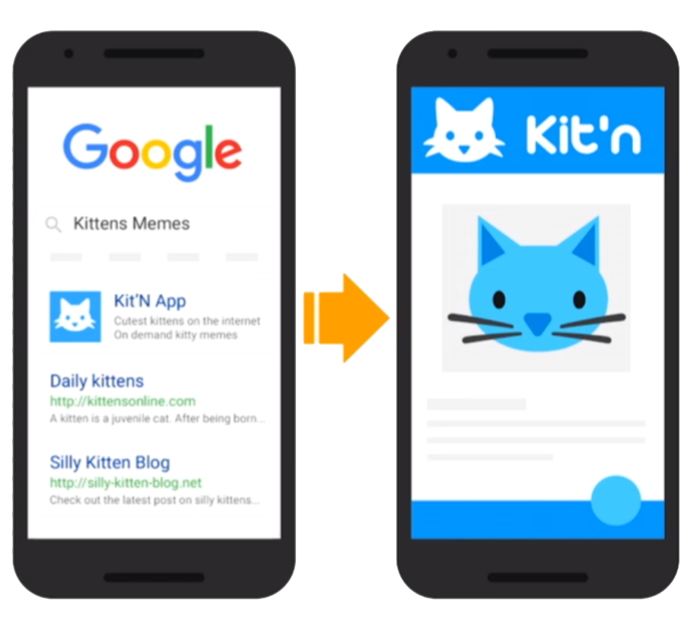
App Indexing
Integrate with Google Search
Index app content
Boost search ranking

Slide 67
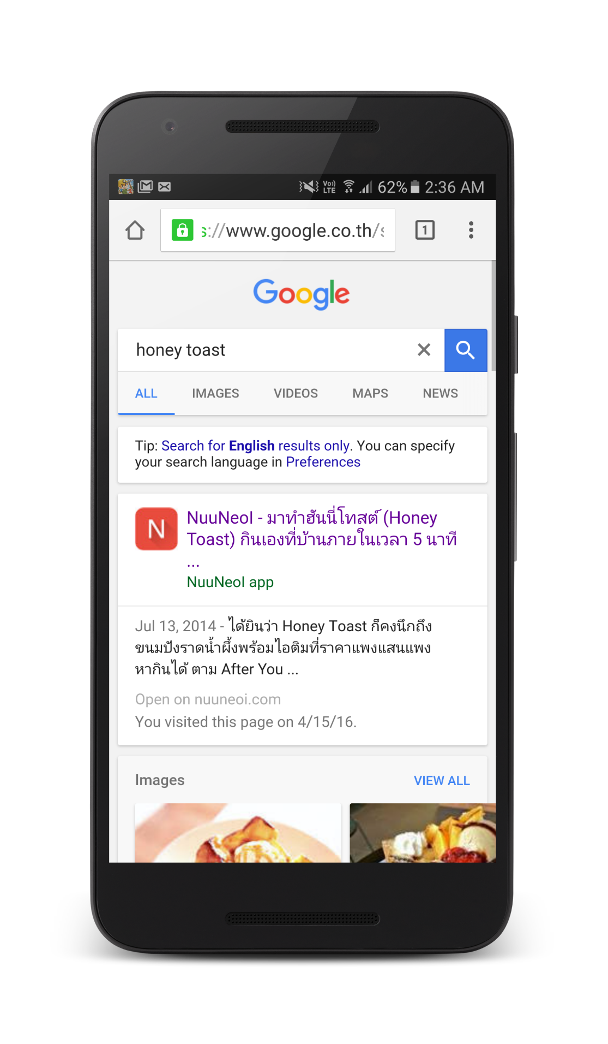
App Indexing

Slide 68

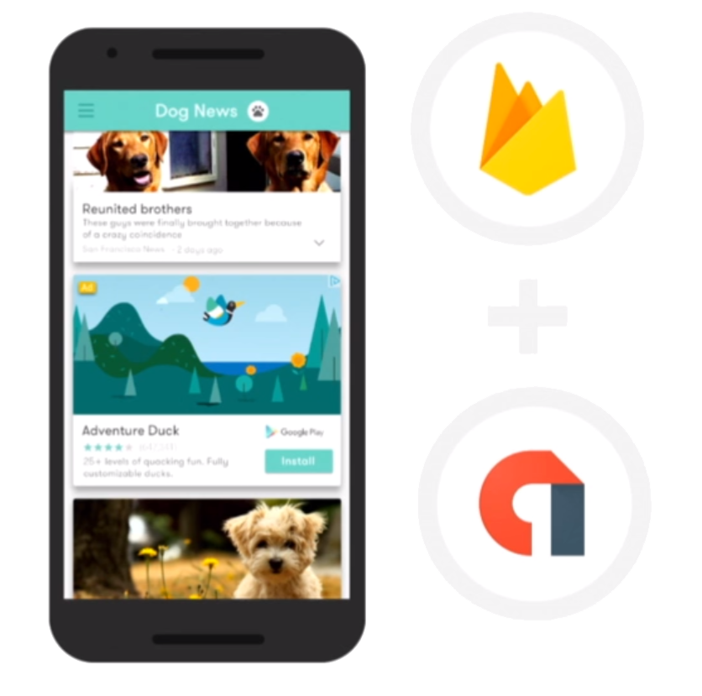
AdMob by Google
Engaging formats: video, interstitial & native
1M+ apps using AdMob
Integrated with Firebase SDK

Slide 69

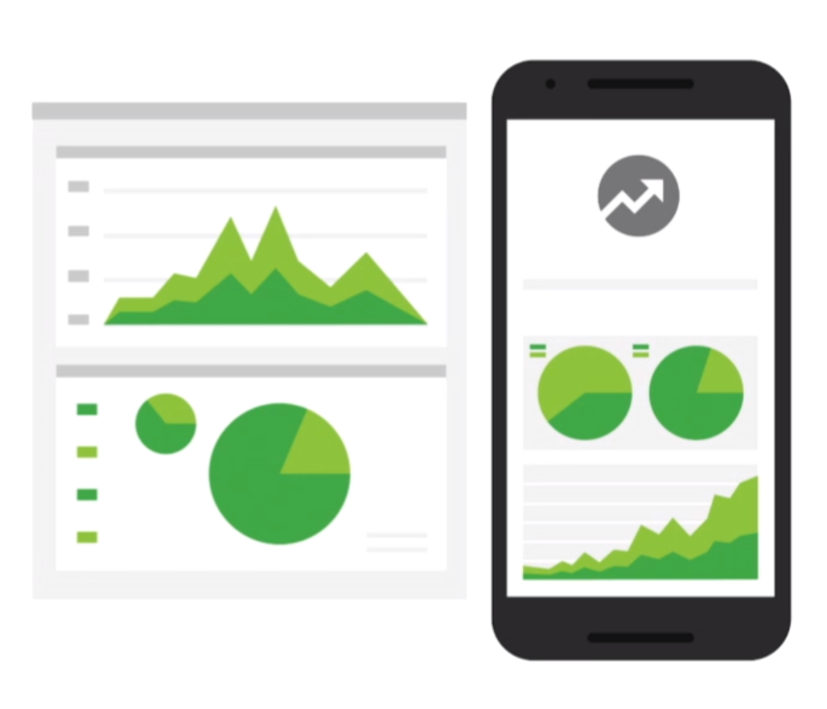
Analytics
Designed for apps
Event and user centric
Connects across Firebase

Slide 70
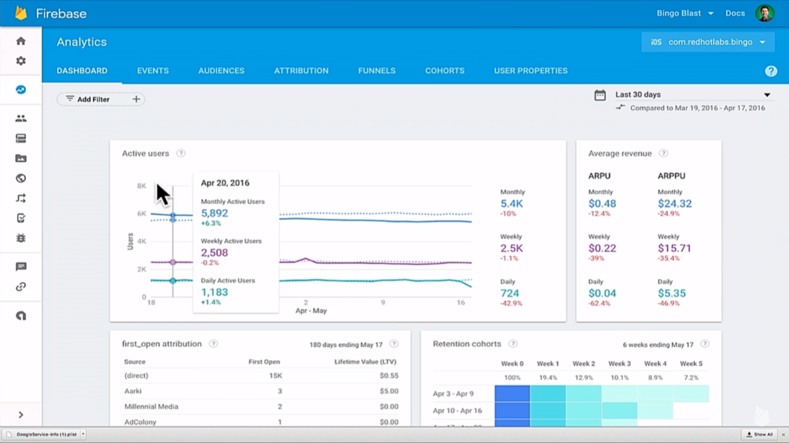

Slide 71
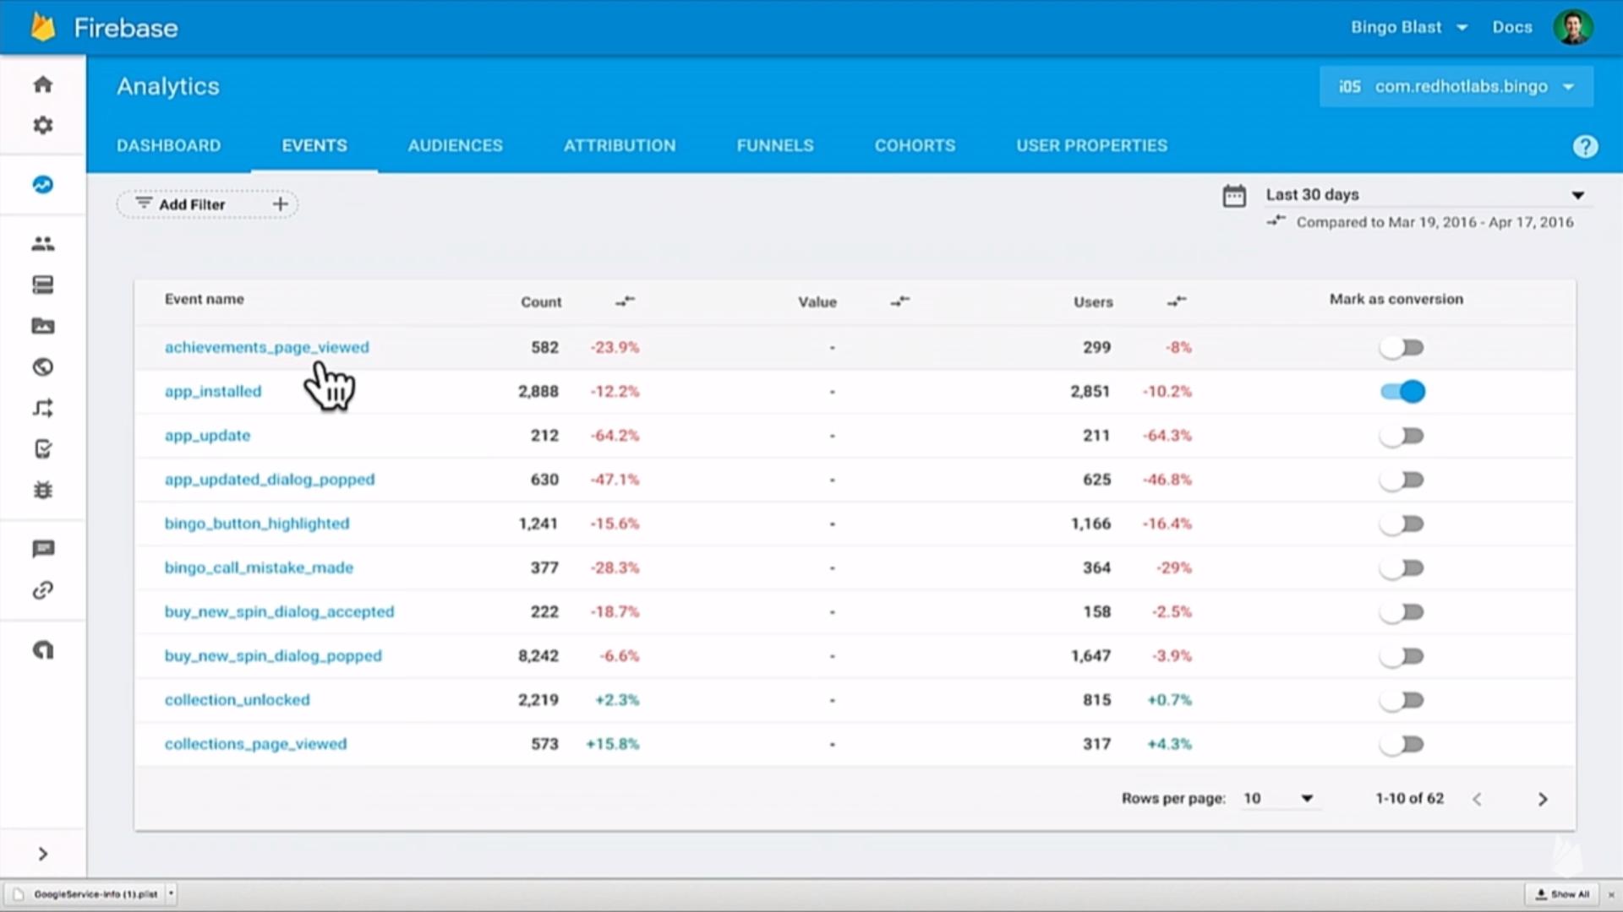

Slide 72
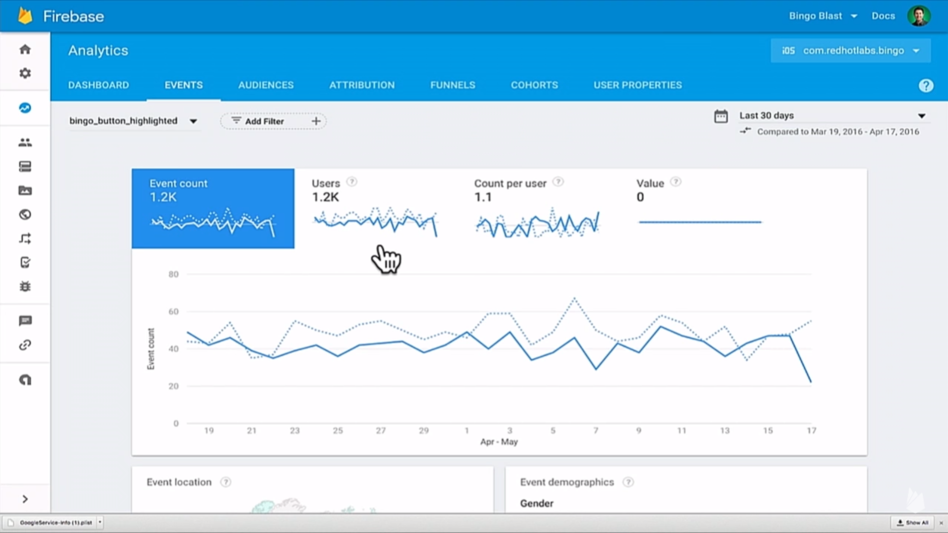

Slide 73
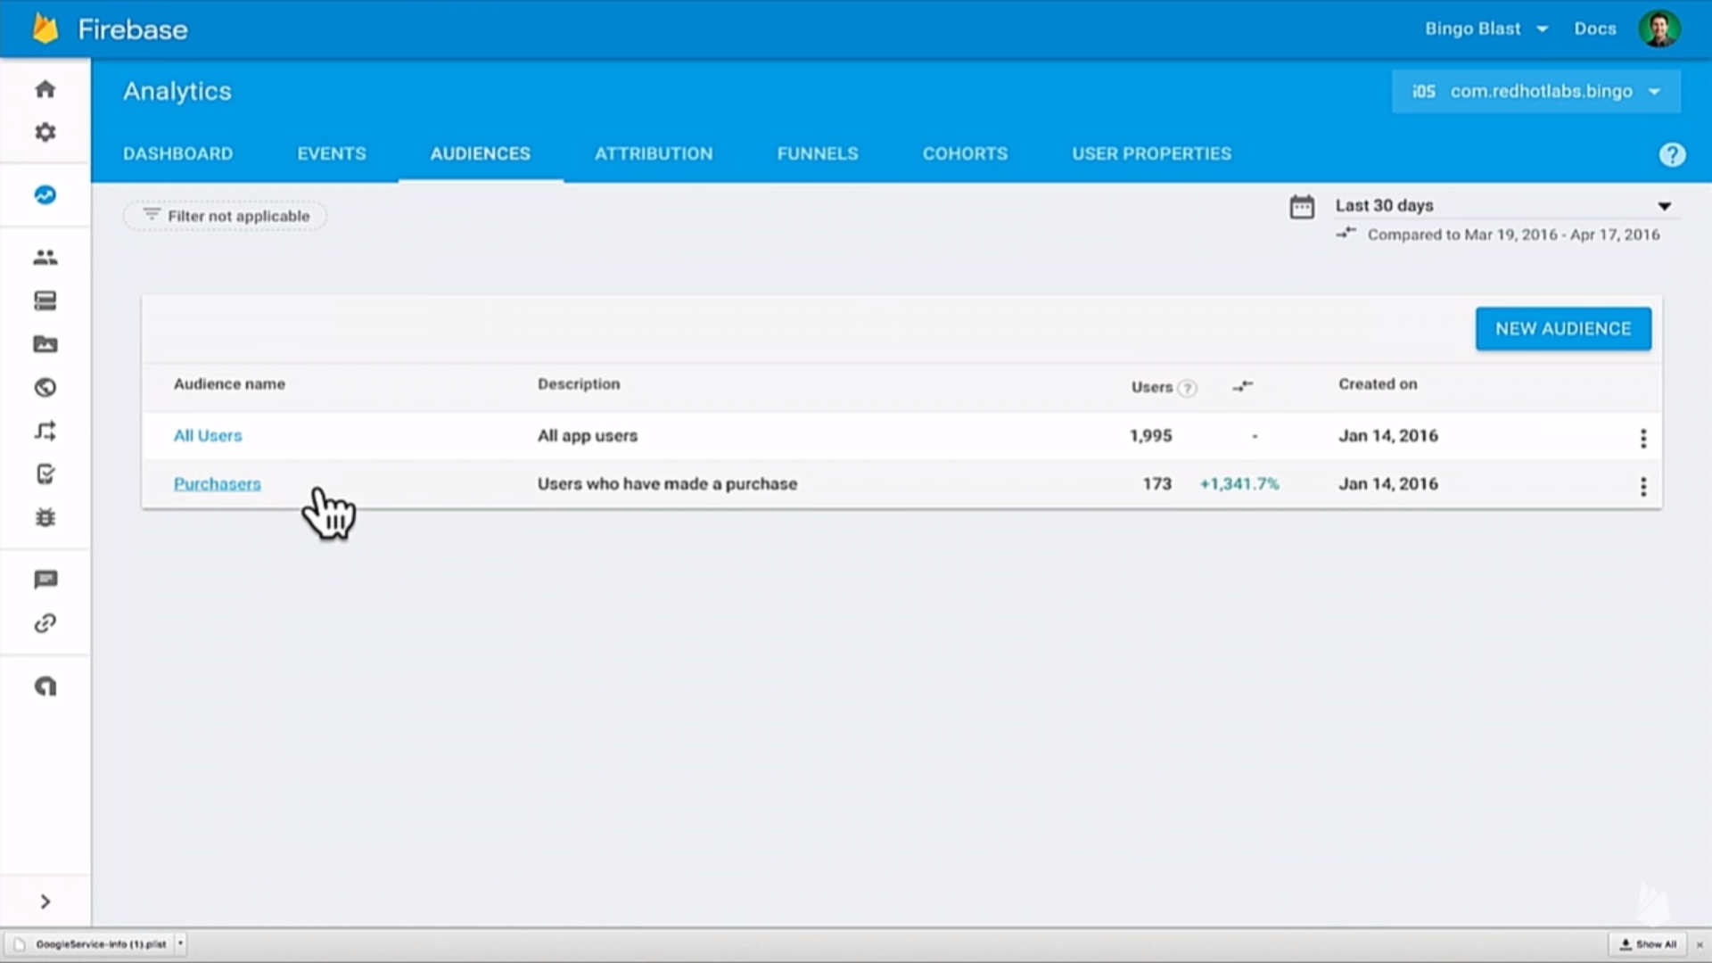

Slide 74
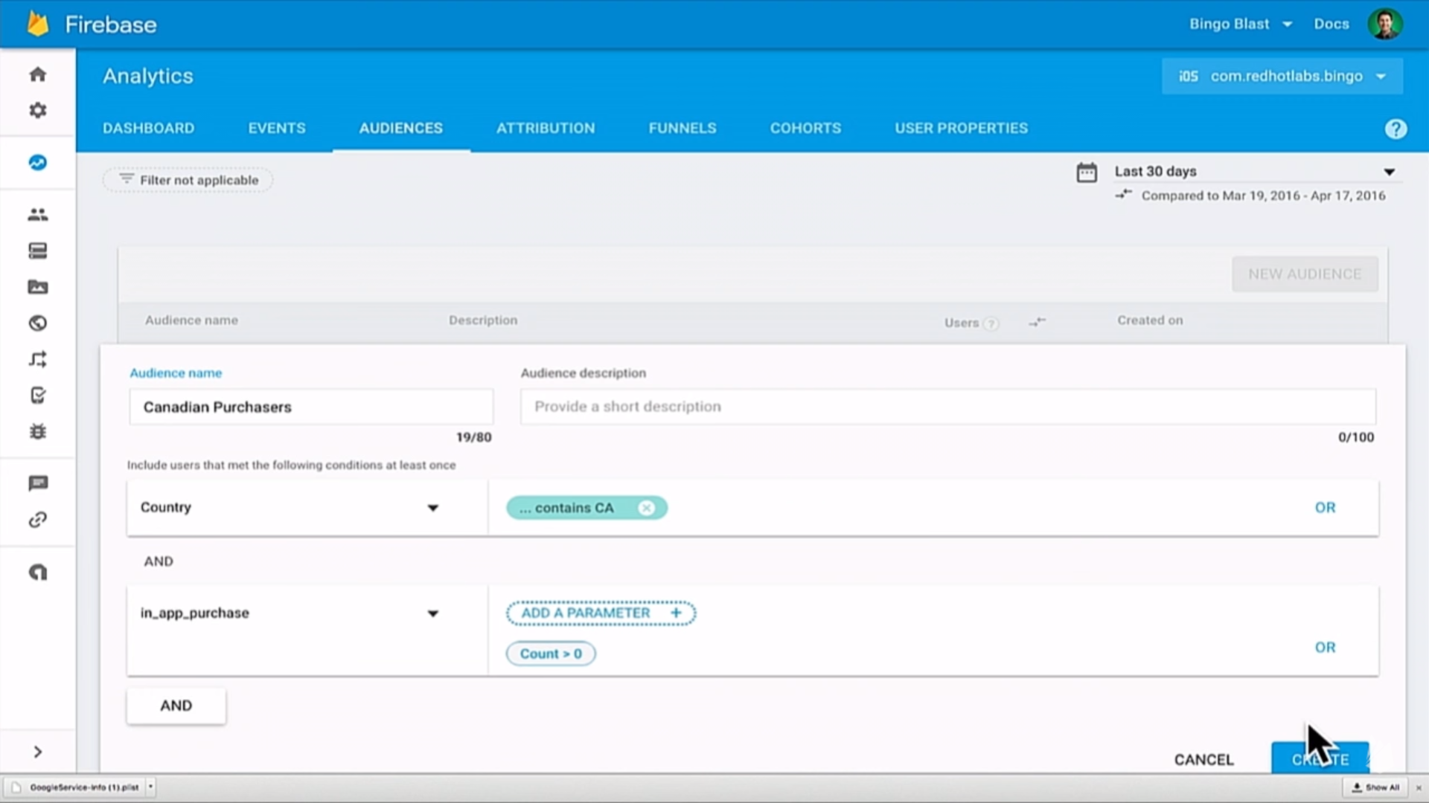

Slide 75
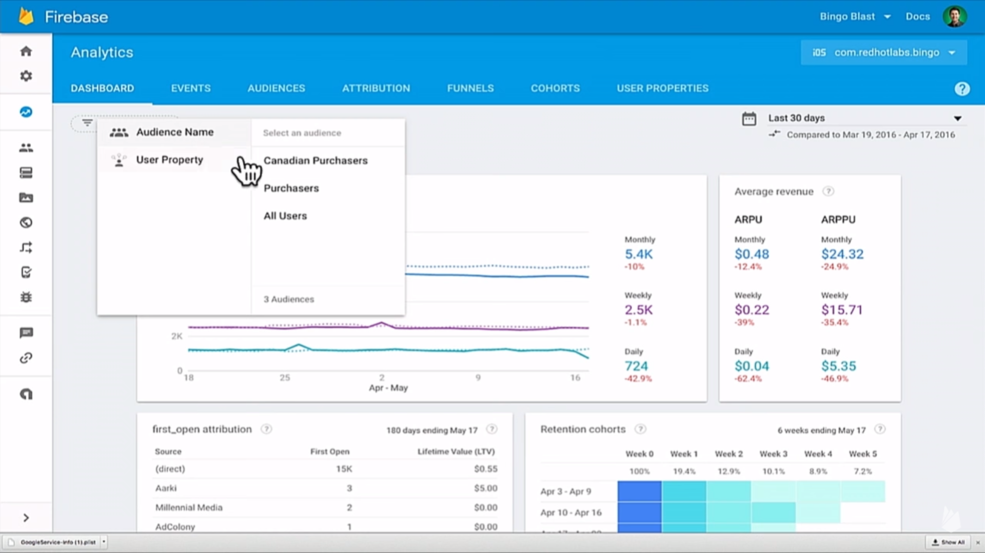

Slide 76
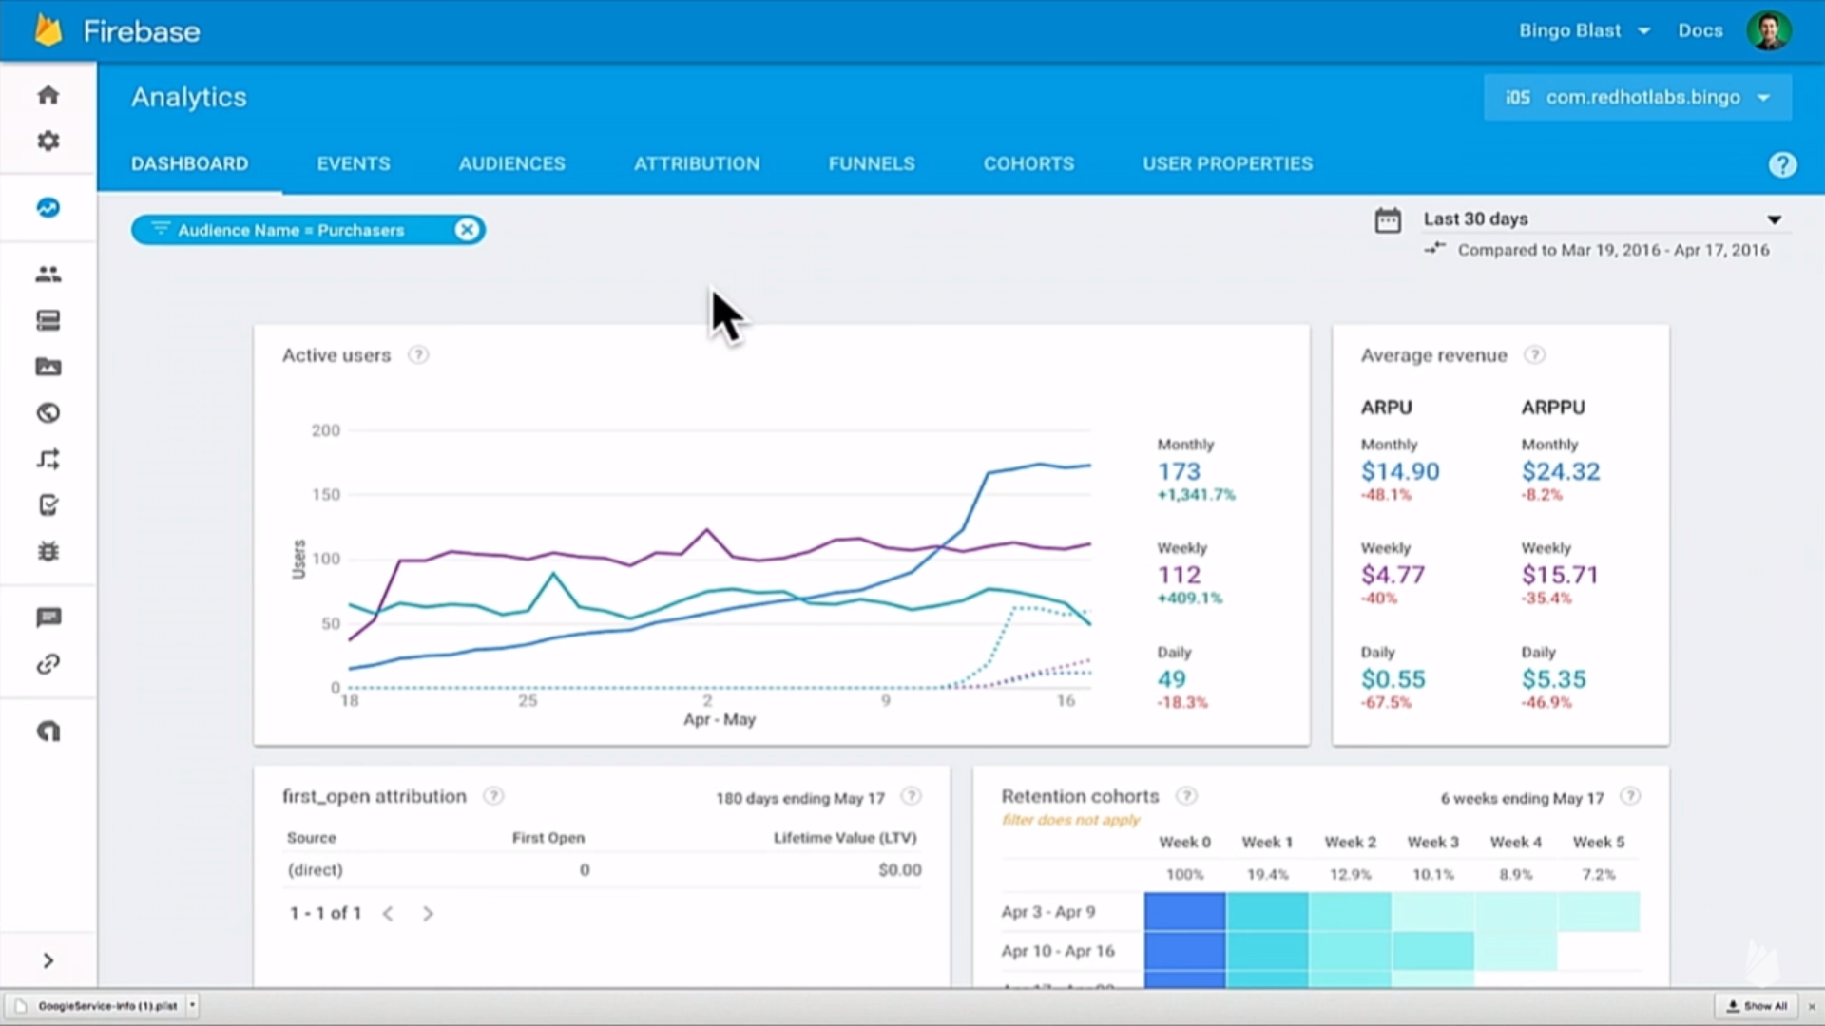

Slide 77
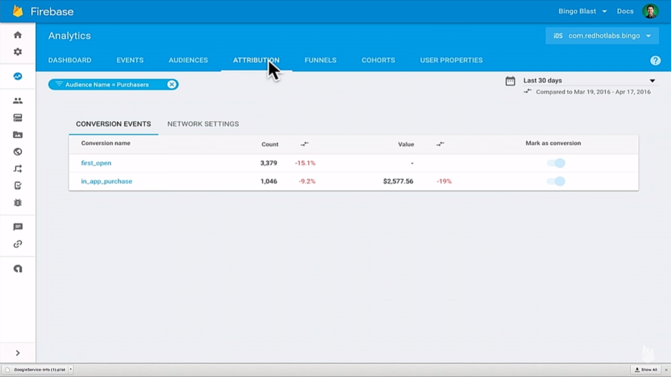

Slide 78
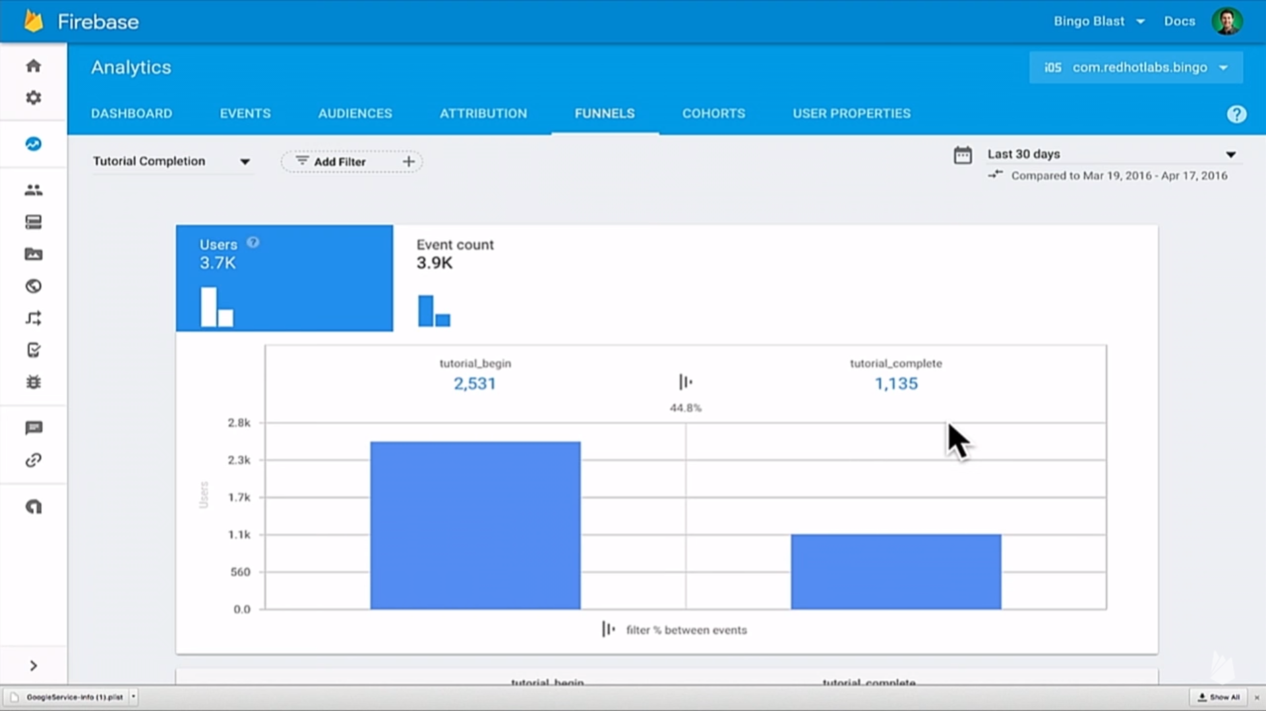

Slide 79
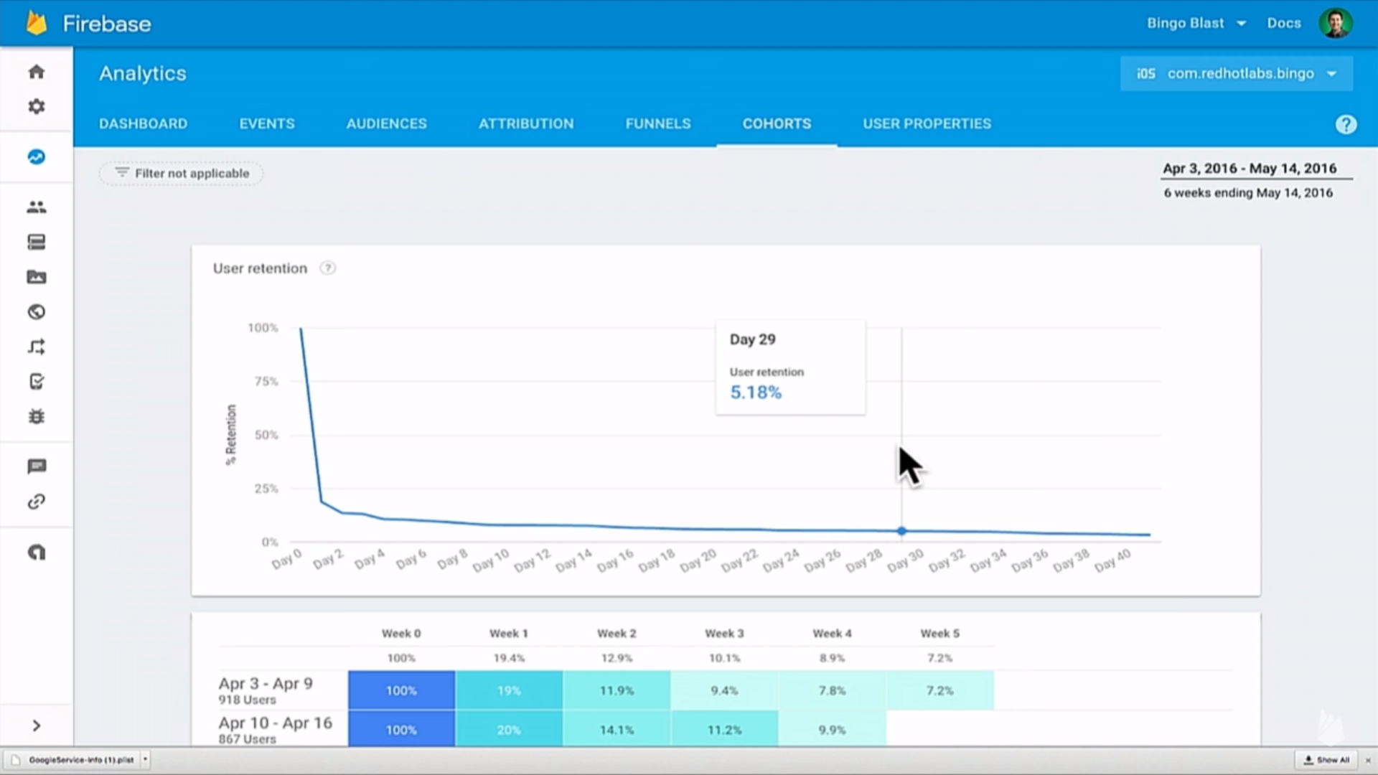

Slide 80
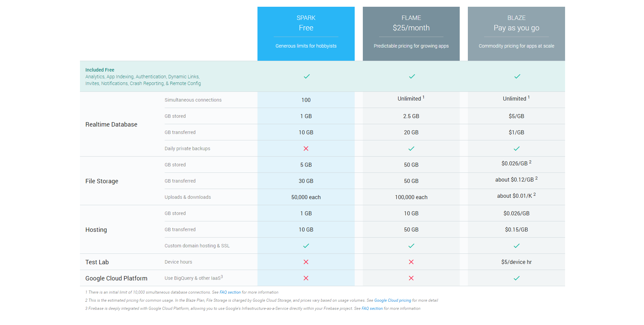
Pricing

Slide 81
DEVELOP
GROW
Backend Services
Realtime Database
Authentication
Hosting
Storage
Cloud Messaging
Remote Config
App Quality Services
Test Lab for Android
Crash Reporting
Acquisition
Dynamic Links
Invites
AdWords
Re-Engagement
Notifications
App Indexing
Analytics
EARN
In-app Ads
AdMob

Slide 82
Thank you

